Slide 1
The Tradeoff between Energy Efficiency and User State Estimation Accuracy in Mobile Sensing
Yi Wang, Bhaskar Krishnamachari,
Qing Zhao, and Murali Annavaram
Ming Hsieh Department of Electrical Engineering
University of Southern California
Department of Electrical and Computer Engineering
University of California, Davis
^{MobiCase ‘09}
^{October 26, 2009}

Slide 2
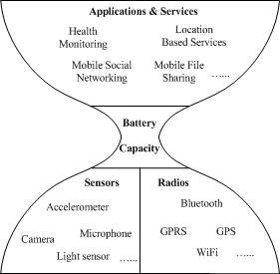
Motivation
The scenario for human-centric, mobile device
based sensing:
Sensors need to be managed intelligently to maintain device/application lifetime
We study two essential but conflicting metrics:
Energy consumption
User state estimation accuracy
Notes:
Here is a figure showing the current situation of mobile device based human centric sensing. Current technologies enable several sensors and transceivers to be built in to a mobile device , such as acc…. On the higher layer, people are designing a huge amount of useful applications based on mobile sensing such as health monitoring, …
However the ultimate bottleneck is the limit amount of mobile device battery capacity.
It is critical in such applications that sensors need to be managed intelligently to maintain device lifetime.

Slide 3
Outline
Problem modeling and assumptions
The stationary deterministic sensing policy
Estimation of user state for missing observations
Visualizing the tradeoff: energy vs. accuracy
Conclusion and Ongoing/future work
Notes:
2. A .. Policy that samples user context information

Slide 4
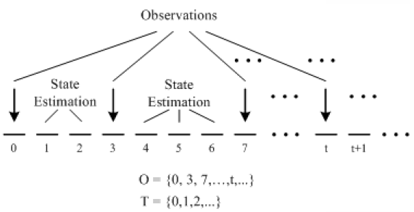
Preliminaries
Model
Sensor samples the user state
sequence according to some
pre-defined policy
Provide state estimation
when observations are missing
Assumptions
Time is discretized
User state transition is Markovian, with N states
In each time slot, the sensor can be either “sampling” or “idle”
If sensor samples
User state is detected at that time slot
A corresponding unit of energy is consumed
Notes:
Mention the tradeoff and say the goal is to identify the tradeoff and find a policy that achieve good tradeoff

Slide 5
The Sensing Policy
A stationary deterministic sampling policy
“If the sensor detects user state i at some time t, it will stay idle for I_{i} time slots, and is re-sampled at time slot t+I_{i}.”
The steady state probability of detecting state i in an observation
Overall expected sampling interval
Define the overall expected energy consumption as:

Slide 6
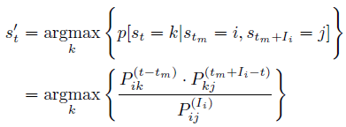
State Estimation
Method 1: Picking the most likely state for each time slot in the estimation interval, given neighboring observations
Expected estimation error for time slot t
Expected per-slot estimation error of the whole process
E[W]: Expected number of incorrect estimations in one estimation interval
E[N]: Expected number of time slots in one estimation interval
i
?
j
t_{m}
t
t_{m} + I_{i}
Estimation interval
Notes:
In our mechanism, the most likely user state maximizes the probability of..

Slide 7
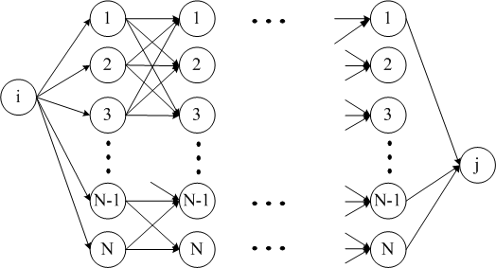
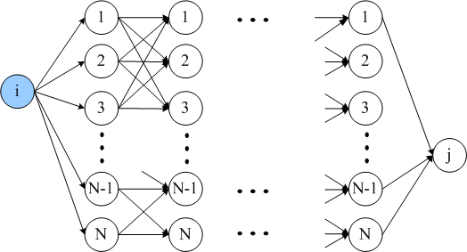
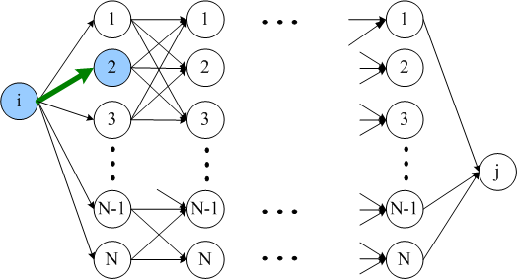
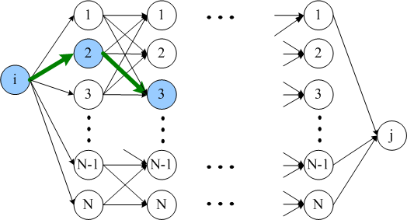
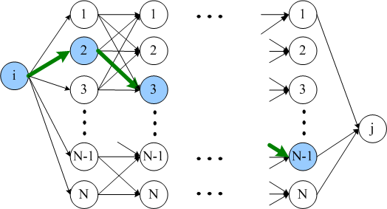
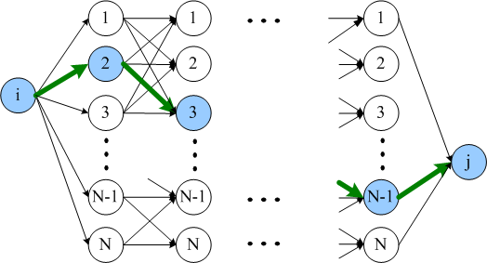
State Estimation
Method 2: Estimate the most likely state sequence for the whole estimation interval, given a leading observation
Always find the highest probability path
Expected sequence error for one estimation interval
Expected sequence error for the whole process
i
?
j
t_{m}
t_{m} + I_{i}
Estimation interval

Slide 8
Case Study
Goal: Visualize the tradeoff between energy consumption and expected state estimation error
By varying I_{i}, the length of idle intervals
Test policy on two-state discrete time Markov chains
Different combinations of I₁ and I₂ are tested (1 ≤ I₁ ≤ 30, 1 ≤ I₂ ≤ 30)
Six Markov chain transition probability matrices are investigated:
Analytical result vs. Simulation result
In simulation, user state data is generated based on Markov model
Policy is applied through the simulation process
5000 time slots in each simulation run
0.9 0.1
0.1 0.9
0.9 0.1
0.5 0.5
0.9 0.1
0.9 0.1
0.5 0.5
0.5 0.5
0.5 0.5
0.9 0.1
0.1 0.9
0.9 0.1
Notes:
Finally compare percentages of incorrect estimations vs groud truth

Slide 9
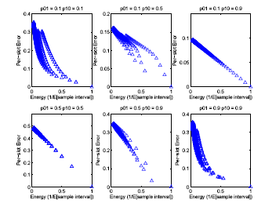
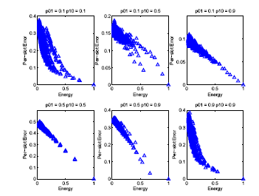
Result: Method 1
Expected per-slot estimation error vs. Expected energy consumption
Analytical
Error range: [0, 1-max{π₁, π₂}]
Simulation
Notes:
Error decreases as energy increases
Characteristic s are different for different matrices
Best tradeoff

Slide 10
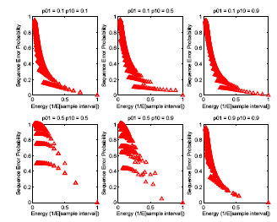
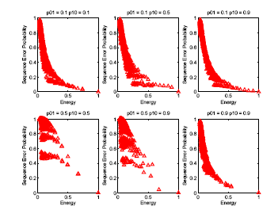
Result: Method 2
Expected sequence estimation error vs. Expected energy consumption
Analytical
Error range: [0, 1]
Simulation

Slide 11
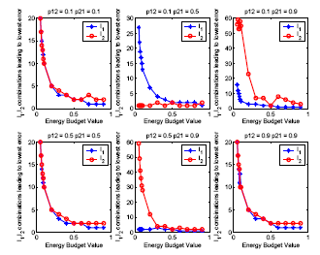
Picking the best policy
An energy budget is given
The optimal stationary deterministic policy can be obtained by
Searching through all sensing interval combinations
The one producing the lowest error is selected
Results for two-state Markov chains
Optimal sensing interval sizes vs.
Energy budget

Slide 12
Conclusion & Ongoing/Future Work
A stationary deterministic sensing policy
State estimation mechanisms
Energy efficiency vs. user state estimation accuracy
The optimal stationary deterministic policy can be obtained by exhaustively search
A more computationally efficient algorithm for optimal policy
Performance of sensing policy on real data trace

Slide 13
More research details available at
http://anrg.usc.edu
Please email to
wangyi@usc.edu

